Slide 1
What’s Your Problem: Pathway to Reasonable Accommodation Success
November 08, 2024

Slide 2
Objectives:
Navigating Self-identification & Disclosure
Functional Limitations
Business Response Disclosure
Retaliatory & Positive Engagement
Attitudinal Change
Notes:
Introduce ourselves and Monica will summarize the objectives.

Slide 3
Identify Barriers
PHYSICAL
COMMUNICATION
ATTITUDINAL
TECHNOLOGY
ORGANIZATIONAL
TRAINING & DEVELOPMENT
SOCIAL
What is a communication barriers? Guideline to overcome communication barriers (thebusinesscommunication.com)
Notes:
Monica
Barriers in the workplace can prevent employees from fully participating and contributing. Here are some common ones:
Physical Barriers: Inaccessible facilities or workspaces, such as a lack of ramps, accessible restrooms, or adjusted workstations, can limit physical access for people with disabilities.
Communication Barriers: Insufficient accommodations like lack of sign language interpreters, inaccessible digital content, and materials not available in alternative formats can hinder those with hearing, vision, or learning disabilities.
Attitudinal Barriers: Biases, stereotypes, or a lack of awareness about disabilities may lead to exclusion, misunderstanding, or reluctance to provide accommodations.
Technological Barriers: Inaccessible software, websites, or tools can prevent employees with disabilities from effectively using necessary technology for their roles.
Organizational Policies: Policies that lack flexibility around remote work, part-time options, or job-sharing arrangements can create obstacles for individuals who may benefit from modified work structures.
Training and Development: Limited access to professional development or skill-building opportunities can create a barrier, especially if accommodations or accessible formats are not offered.
Social Barriers: Social exclusion or lack of support systems, like mentoring or peer networks, can prevent individuals from integrating fully into the workplace culture.
Addressing these barriers often involves creating accessible environments, providing appropriate accommodations, promoting inclusive culture, and enhancing awareness among staff.

Slide 4
Self-ID: Self-Disclosure
TRUST
COMMUNICATION
TRAINING EDUCATE
MESSAGING & MARKETING
OPTIONS
EXPLAIN
Self-Disclosure: 9 Tips To Practice Healthy Self-disclosure (mind.help)
Notes:
Monica

Slide 5
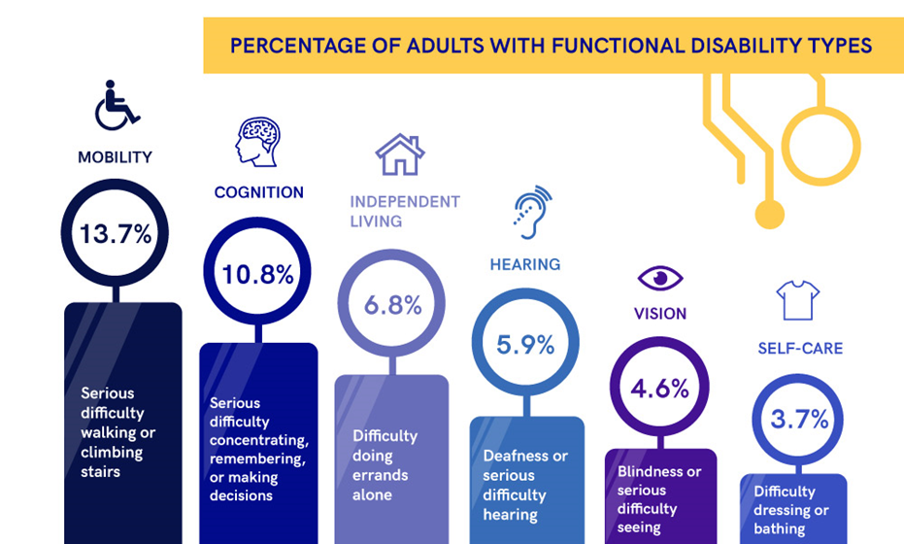
Functional Limitations
Section 508 Compliance Checklist (pixelplex.io)
Notes:
Monica
According to ADA Guidelines: Functional limitations refer to restrictions in an individual's physical, mental, or sensory abilities that impact their ability to perform certain tasks or activities. These limitations can vary widely in severity and nature, depending on the individual and the context. Functional limitations may affect:
Physical abilities: e.g., challenges with mobility, dexterity, or strength, which can impact tasks like walking, lifting, or standing.
Cognitive abilities: e.g., difficulties with memory, concentration, or problem-solving, which may interfere with learning, organizing, or decision-making.
Sensory abilities: e.g., impairments in vision or hearing, affecting activities that require clear sight or sound, such as reading, interpreting non-verbal cues, or understanding spoken information.
Social/Communication skills: e.g., challenges in interpreting social cues or maintaining conversations, which might influence interactions in personal or work settings.
These limitations may stem from physical or mental health conditions, developmental disabilities, injuries, or chronic illnesses. They are often considered in disability accommodations to improve accessibility and performance in work, educational, or community settings.

Slide 6
Deal with the Issue(s)
A functional limitation refers to a restriction or impairment that affects an individual's ability to perform basic activities or tasks.
Functional
Limitation
Scenario
Fragrance / Odor Sensitivity
The Process
ADA
Reasonable Accommodations
This Photo by Unknown Author is licensed under CC BY-SA
Notes:
Jackie
A functional limitation refers to a restriction or impairment that affects an individual's ability to perform basic activities or tasks. This limitation can be due to physical, mental, sensory, or cognitive impairments and may impact daily activities, work tasks, or social interactions. Functional limitations can vary widely, depending on the person and condition, and may include challenges with mobility, communication, self-care, problem-solving, or interacting with others. They are distinct from a specific medical diagnosis and instead focus on the practical effects of a condition on a person’s day-to-day functioning.
Functional limitations are often considered when evaluating the need for accommodations, services, or support to help the person participate fully in different settings, such as the workplace or community.
Deal with the Problem:
Focus on functional limitations not the diagnosis (scenario as an example)
Process to Initiate Reasonable Accommodation

Slide 7
Scenario
Fragrance Sensitivity
Body Odor
Chemical Smells
Building Odor
Notes:
Jackie
Cancer/Migraine/Respiratory Condition(s)/Mildew

Slide 8
The Process
The reasonable accommodation process involves several key steps to ensure employees with disabilities receive the support they need to perform their jobs effectively.
What’s the ADA Interactive Process and Why is it a Big Deal? (briotix.com)
Notes:
Jackie
The reasonable accommodation process involves several key steps to ensure employees with disabilities receive the support they need to perform their jobs effectively. Here’s an outline of the typical action steps:
Initiate the Request:
The employee, their representative, or a healthcare provider makes an accommodation request. This can be formal or informal, depending on the company’s policies.
Managers should be trained to recognize when an accommodation request may be implied (such as if an employee states difficulty performing certain tasks).
Acknowledge and Review the Request:
Acknowledge receipt of the request promptly and inform the employee of the process, including any forms or documentation required.
Identify what specific job tasks or functions may be impacted by the functional limitation, as related to the request.
Gather Information and Assess Needs:
Work with the employee to understand their specific limitations and needs. In some cases, additional medical documentation may be requested if necessary to clarify the need for accommodation.
Evaluate if the request directly addresses functional limitations and does not pose undue hardship for the organization.
Explore Accommodation Options:
Collaborate with the employee, HR, and any relevant parties (such as vocational rehabilitation specialists) to identify potential accommodations.
Consider a range of options that meet both the employee’s needs and the business’s ability to provide the accommodation effectively.
Implement the Accommodation:
Implement the agreed-upon accommodation in a timely manner. Accommodations may include adjustments in work schedules, assistive technology, modifications in work tasks, or physical adjustments to the workspace.
Provide any necessary training for the employee or their team to ensure smooth integration of the accommodation.
Monitor and Review:
Periodically review the effectiveness of the accommodation to ensure it continues to meet the employee’s needs.
Make adjustments as needed, especially if the employee’s job role or functional limitations change over time.
Document the Process:
Maintain documentation of each step of the process, including communications, the specific accommodation provided, and any evaluations or follow-ups.
Documentation is important for compliance, ongoing support, and addressing any future needs or adjustments.
Following these steps helps organizations create a structured, fair, and legally compliant approach to accommodating employees, ensuring a supportive work environment.

Slide 9
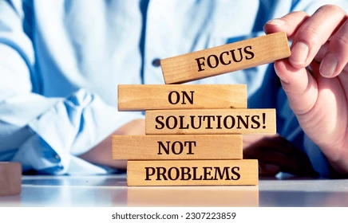
Manage the Issue(s)
Fragrance / Odor Sensitivity
Situation
Response
ADA
Reasonable Accommodations
Reaction
Resolution to the Problem / Positive Outcome
Notes:
Jackie
A functional limitation refers to a restriction or impairment that affects an individual's ability to perform basic activities or tasks. This limitation can be due to physical, mental, sensory, or cognitive impairments and may impact daily activities, work tasks, or social interactions. Functional limitations can vary widely, depending on the person and condition, and may include challenges with mobility, communication, self-care, problem-solving, or interacting with others. They are distinct from a specific medical diagnosis and instead focus on the practical effects of a condition on a person’s day-to-day functioning.
Functional limitations are often considered when evaluating the need for accommodations, services, or support to help the person participate fully in different settings, such as the workplace or community.
Deal with the Problem:
Focus on functional limitations not the diagnosis (scenario as an example)
Process to Initiate Reasonable Accommodation

Slide 10
Situation
This Photo by Unknown Author is licensed under CC BY-SA
Notes:
Lisa-ask the audience a question

Slide 11
Situation
This Photo by Unknown Author is licensed under CC BY-SA
Notes:
Lisa-ask the audience a question

Slide 12
Response
Communicate
Educate
Utilize Resources
Seek Support
Notes:
Lisa

Slide 13
Reaction
Timeliness
Training & Awareness
Open Communication
Policy Development
Workspace Adjustments
Notes:
Lisa

Slide 14
Not a Problem, Enhancing Potential
Notes:
Everyone makes a contribution to this slide:
We all play a role in this process.
Agency
Vendors
Employers

Slide 15
Resources
ADA National Network
800.949.4232
www.adata.org
Employer Assistance and Resource Network
(EARN)
AskEARN | Accessible Interviews
The Job Accommodation Network (JAN)
800.526.7234
www.askjan.org
Equal Employment Opportunity Commission (EEOC)
ADA Information Line
800.669.4000 (Voice)
800.669.6820 (TTY)
www.eeoc.gov
U.S. Access Board
202.272.0080 (Voice)
ta@access-board.gov
Upcoming Webinars & Trainings (access-board.gov)

Slide 16
Conclusion
Notes:
Lisa closes us out with a summary about attitudinal change as noted in the beginning of the presentation.
Shows an embedded video.

Slide 17
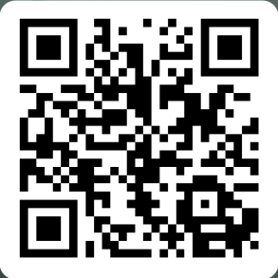
Survey

Slide 18
Closing Slide with Contact Information
Lisa Stanley, MA, LPC, CBSP
Region-8
269.548.7282
Stanleyl@michigan.gov
Jaquelyn Smith, MSW, CBSP
Region-10
313.236.8090
SmithJ66@michigan.gov
Monica Robbins, MA, LPC, ADAC
Region-4a/b
517.250.1726
Robbinsm1@michigan.gov
Facebook
MichTalent
X
MichiganTalent
LinkedIn
Michigan Talent

