Slide 1
Attitude of Gratitude What are you thankful for? I am thankful for…..
My improved golf game that got better after retirement ☺
……….
………..

Slide 2
Spiraling Up The Ethics of Self Care and Well Being
Rosanne Renauer PhD, LLP, CRC
November 7,2024

Slide 3
Long term MRA, MAMRC and NARL member Join! ☺
PhD Rehabilitation Counselor Education
35 + Years at Michigan’s state vocational rehabilitation services agency
Invited to speak at International Vocational Rehabilitation Conference in Taipei, Taiwan
Yoga Teacher
“Go to the people. Learn from them. Live with them. Start with what they know. Build with what they have. The best of leaders when the job is done, when the task is accomplished, the people will say we have done it ourselves.” -Lao Tzu

Slide 4
Just Breathe….
Ujjayi breath aka Ujjayi Pranayama, the vital life force prana (pronounced oo-jai)
Inhalation and exhalation are both done through the nose for similar counts
"the ocean breath“, "victorious breath“
stay present, self-aware and grounded

Slide 5
Learning Objectives
Understand the importance of addressing an ethical obligation to remain competent in practice
Identify and apply four foundational principles of self care: Flourishing, intentionality, reciprocity in care of self and others and integration of self-care into life.
Identify effective personal and workplace strategies that result in positive support to wellness.
Utilize assertiveness skills effectively in the practice of personal wellness
Understand the impact and role of individual leadership in pursuit of wellness and building resiliency skills.

Slide 6
Ethics- Do the right thing
A system of beliefs that affect behavior
Professions usually have a code of ethics that support the “right” actions
A standard of behavior to be met
Conflict between your personal ethics and job expectations can create conflict and burn out
Whether this framework gets used in the workplace depends upon a variety of factors including the culture of the workplace, worker familiarity with ethical behavior and choices, supervisory comfort with difficult decision making, time. The important thing to acknowledge here is that often in today's workplaces, we are confronted with policies that do not fit our moral choices. When this happens, it can lead to disenchantment and burn out.

Slide 7
Self Care and Wellness as an Ethical Imperative
APA code of ethics 2.06, parts A. B.
CRC code of ethics D.3
ACA code of ethics C.2.G
…..counselors engage in self-care activities to maintain and promote their own emotional, physical, mental, and spiritual well-being to best meet their professional responsibilities.
Do you have an obligation to be competent? Are you a professional? Competence is the essence of professionalism and competence is an essential ethical obligation. It provides a critical link between ethics and self-care. As a professional, you accept certain responsibilities and obligations.

Slide 8
CRC D.3. FUNCTIONAL COMPETENCE a. Impairment
Helping Professionals are alert to the signs of impairment due to their own health issues or personal circumstances and refrain from offering or providing professional services when such impairment is likely to harm clients or others. (Self awareness)
They seek assistance for problems that reach the level of professional impairment, and if necessary, they limit, suspend, or terminate their professional responsibilities until it is determined they may safely resume their work. (Actively seek help)
Helping Professionals assist colleagues or supervisors in recognizing their own professional impairment, provide consultation and assistance when colleagues or supervisors show signs of impairment, and intervene as appropriate to prevent harm to clients. (Other directed )

Slide 9
COMPETENCY is an ethical responsibility! Put on your own oxygen mask first. Is an oxygen mask enough or is a parachute needed? There’s a global crisis among professional helpers, with huge numbers of teachers, clergy, nurses, social workers, and therapists (among others) quitting, planning to quit, or seriously considering quitting their jobs.

Slide 10
What SOME People Think Self-Care Is What Self-Care Actually Is
Overindulgence in spending
Binge-eating your favorite but unhealthy foods
Participating in activities that provide instant gratification
Going on expensive and lavish vacations
Perfecting oneself by any means necessary
Numbing bad feelings using alcohol or illicit substances
Binge-watching television
Prioritizing one's physical and mental health
Adopting healthy lifestyle habits that can be maintained long-term
Eating a healthy diet
Finding exercise activities that you enjoy and participating in them regularly
Getting an adequate amount of good-quality sleep
Following treatment plans for existing conditions accordingly
Taking time out for yourself to participate in healthy activities you enjoy
What Types of Self-Care by Angelica Bottaro

Slide 11
Definition of Self Care ongoing practice of seeking positive experiences, healthy choices in order to maintain personal and professional well being
For a person to practice true self-care, they must use personal responsibility and self-reliance in a way that positively impacts their health in the current moment and the future.

Slide 12
Wellness means overall well-being. It is an ongoing process and a life-long journey, not a one-time event. There are eight interconnected dimensions of wellness that require attention in order to build everyday habits, which improve quality of life. It may also help individuals live longer, manage current health conditions, and support recovery from illness, injury, and addiction.
Definition of Wellness
Physical
Emotional
Social
Intellectual
Environmental
Spiritual
Vocational
Financial
Northwestern University website

Slide 13
The Relationship between Self Care and Wellness
Self-care is linked to improved mental health, self-esteem, self-worth, and optimism.
Self-care involves valuing ourselves enough to make our health, well-being, and happiness a priority.
We often don't take enough care of ourselves, which can have long-term effects on well-being.
The Connection Between Self-Care and Mental Health by Monica Vermani C. Psych.

Slide 14
Benefits of Self Care and Wellness
Long-Term
Managing chronic conditions
2National Institute of Mental Health. Caring for your mental health.
Disease prevention reduces the risk of heart attack, stroke, and obesity in the future.⁷
Stress reduction: lower the risk of developing health conditions: heart disease, high blood pressure, gastrointestinal disorders
Healthier relationships: better able to engage in healthy relationships partially due to increased self-esteem and self-worth.
Improved job satisfaction: A study of nurses found those who implemented intentional self-care practices had significantly higher job satisfaction. The authors suggest implementing self-care practices could improve job satisfaction and teamwork and reduce burnout.⁹
Reduced burnout: Authors of a review of multiple studies concluded the solution for burnout is complex, but self-care strategies are one of several components that could be effective.¹⁰
Improved quality of life: When self-care practices help to better manage health conditions, reduce stress, or create a greater sense of belonging, overall well-being and quality of life improve.
Short-Term
Reduced stress levels: Putting your health and needs first along with giving yourself a bit of rest can significantly reduce stress levels.
Increasing self-worth: The more you take care of yourself, the better you will feel about who you are as a person. More of your core needs will be met regularly.
Feelings of belonging: A short-term benefit of spending time with others will provide feelings of belonging and love, which is good for your overall mental health.

Slide 15
“Dr. Tudbelly eyed the distraught Lionel. ‘What are your symptoms? Do you feel baffled? Bewildered? Confused? A little edgy? Frightened? Puzzled?’
‘Yes, yes!’ cried Lionel. ‘All of that!’
‘Good,’ said Dr. Tudbelly. ‘You’re quite normal.’
‘But what shall I do?’
‘Why, the same as any sensible person in the circumstances. Keep going. Hope for the best.’
This advice gave Lionel no comfort, but he could do no more than follow it. Choking back his distress, he plucked up as much heart as he could and started off again.”
(Lloyd Alexander, The Cat Who Wished to Be a Man, p. 67)

Slide 16
When you are overwhelmed…..
QUICK TIPS!
1. Focus on what you can control
2. Adopt a Resilience Slogan or Theme Song
3. Let Yourself Not Be Okay for a While
4: Don’t Throw Good Time After Bad
5: Ignore One-Size-Fits-All Solutions
Catherine Hannay,MA, 5 Ways to Practice Self-Care When You’re Exhausted and Overwhelmed

Slide 17
video
https://www.youtube.com/watch?v=w0iVTQS8ftg

Slide 18
Four Foundational Principles for Well Being
Flourishing
Intentionality
Reciprocity
Integration
T
Wise, E. H., Hersh, M. A., & Gibson, C. M. (2012). Ethics, self-care and well-being for psychologists: Re-envisioning the stress-distress continuum. Professional Psychology: Research and Practice, 43(5), 487.

Slide 19
Flourishing Versus Survival
Broad Array of Possibilities in your personal and professional life
Resilience Building and Responsiveness
Positive Orientation
Maintaining the Status Quo is NOT “good enough”

Slide 20
Flourishing Versus Survival AKA Less Stress, More Joy
1. Recognize what is causing your stress
2. Plan ahead to reduce stress in the moment
3. Create boundaries so you have room and time for yourself
4. Connect with others
5. Practice deep breathing and or mindfulness
6. Add more joy!

Slide 21
Intentionality
Informed Choice
Decision making
With meaning not grasping at straws
Synonyms deliberateness, intent, design, calculation, premeditation, preconception, forethought, plan, planning, preplanning, advance planning, prearrangement, aforethought

Slide 22
Reciprocity
Win-Win
Process of dynamic exchange of lifestyle attitudes and practices between counselor and client
The health and maturity of the teacher/counselor is essential for cultivating the health and maturity of student/client
Ethicality of interacting and giving and getting from each other

Slide 23
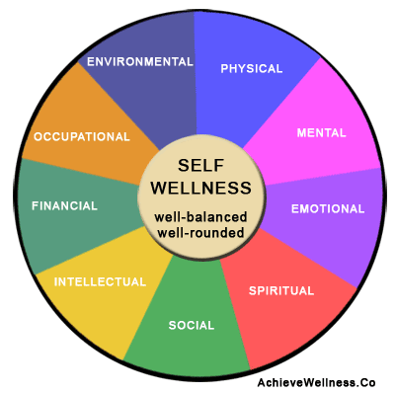
Integration
an act or instance of combining into an integrated whole.

Slide 24
How do we move from Survival Mode to Flourishing???
How do we become Intentional???
How do we engage in Reciprocity???
How do we integrate into a joyful whole??

Slide 25
Flourishing Three areas of life working together toward a common goal, a life of purpose
Health and wellness: What does it mean to you?
Happiness: What is happiness, and does it exist on a continuum? What does it mean to you?
Success means different things to different people. What does it mean to you?
The Year of No Nonsense by Meredith Atwood: How to get over yourself and on with your life.

Slide 26
Flourishing versus Survival
1. Have you identified your triggers? Do you need to?
2. What are the reasons you don’t engage in self care? Be specific. Are there underlying reasons?
3. What are some of the ways that you engage in self-care? Do you have a favorite? Why is this your favorite? What does this have in common with other aspects of self-care that you benefit from?
4. Identify a current goal for self-care. Once you have a broad idea, narrow it down to a SMART formula: Be specific., measurable, achievable, realistic and time oriented
A STUDY GUIDE for Ethical Self Care
Rosanne Renauer®

Slide 27
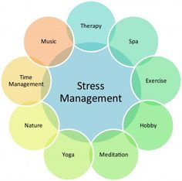
Self Care and Stress Busters
What do you use?
Does it work for you? How do you make it work for you?
Is there another technique that you can visualize yourself using?

Slide 28
SMART GOALS? Intentionality
SMART formula: Be specific, measurable, achievable, realistic and time oriented
Example: SMART goal for waking up earlier
Specific: I want to wake up earlier to have more time for my morning routine.
Measurable: I’ll track how many times I snooze my alarm and when I finish my morning routine.
Attainable: My schedule allows me to go to sleep early, so I can still maintain at least eight hours of sleep.
Relevant: I feel rushed trying to get to work each day. Developing better sleep hygiene would help me feel calm.
Time-bound: In four weeks, I want to wake up two hours earlier than when I usually wake up now.

Slide 29
Integration into a Joyful Whole Finding Meaning in your life
Talents, Strengths, Skills and Gifts
Clarify Values
Spiritual Calling
Passion
Goals
Saying No, setting limits
Saying Yes, engaging
Action and Motivation

Slide 30
This Photo by Unknown Author is licensed under CC BY-SA
This Photo by Unknown Author is licensed under CC BY-SA-NC
This Photo by Unknown Author is licensed under CC BY-NC

Slide 31
What would your superpower be and why?
You can put your answer in the chat.

Slide 32
QUESTIONS?

Slide 33
Let’s talk about STRESS ABC Strategy
A= AWARENESS What causes you stress? How do you react?
B= Balance How much can you cope with before it becomes negative stress?
C= Control What can you do to help yourself combat the negative effects of stress?

Slide 34
The Relationship Between Stress and Disease
Contagious diseases vs. chronic diseases
Biopsychosocial model
Health psychology
Health promotion and maintenance
Discovery of causation, prevention, and treatment

Slide 35
Effects of Stress: Behavioral and Psychological
Impaired task performance
Burnout
Psychological problems and disorders
Positive effects

Slide 36
Major Types of Stress
Frustration: blocked goal
Conflict: incompatible motivations
Approach-approach
Approach-avoidance
Avoidance-avoidance
Change: having to adapt
Social Readjustment Rating Scale
Life Change Units
Pressure
Perform/conform

Slide 37
Specific Stressors
Performance expectations
Client demands and inability to meet demands
Lack of competent support
Low job control
Boredom
Coworker conflict
Management-Labor conflict
Second jobs
Marital/Family spillover
NEW PANDEMIC and pandemic related stress
NEW The election and politics

Slide 38
Factors Moderating the Impact of Stress
What factors moderate or influence stress?
Social support
Increased immune functioning
Optimism
More adaptive coping
Positive explanatory style
Conscientiousness
Fostering better health habits
Autonomic reactivity
Cardiovascular reactivity to stress
Many factors moderate the effects of stress on illness, and individual differences in impact appear to be related to these moderating variables.
Social support, or the various types of aid and succor provided by members of one’s social network, appear to decrease the negative impact of stress.
Having an optimistic style also appears to lead to more effective coping with stress, while pessimistic styles have been related to passive coping and poor health practices.
Conscientiousness also appears to be related to increased longevity, possibly because being conscientious leads to better health habits.
Finally, physiological factors, such as cardiovascular reactivity to stress, appear to play a role in how significant the impact of stress is on an individual.

Slide 39
In the Workplace Implications for treatment
Identification of counselors/professionals at high-risk
No penalty or stigmatization
Potential interventions
Psychoeducation
Work redesign
Coping skills training
Relaxation training
Conflict-resolution training
Leadership training
Sleep hygiene education

Slide 40
Sustainable Self Care and Wellness is founded on:
Spirituality
Mindfulness
Positive Psychology

Slide 41
SPIRITUALITY
Spirituality is a broad concept with room for many perspectives. In general, it includes a sense of connection to something bigger than ourselves, and it typically involves a search for meaning in life. As such, it is a universal human experience—something that touches us all. People may describe a spiritual experience as sacred or transcendent or simply a deep sense of aliveness and interconnectedness.
This Photo by Unknown Author is licensed under CC BY-SA
This Photo by Unknown Author is licensed under CC BY-SA

Slide 42
Mindfulness Be In The Moment!
Evidence Based Treatment
Paying attention in a particular way; on purpose, in the present moment and nonjudgmentally
Involves intention: purposeful and conscious choice of where and how we direct our attention moment to moment and over the long term
A specific type of attention observing with healthy disengagement one’s experiences
Attitudes of non striving, acceptance and curiosity

Slide 43
Benefits of Mindfulness
Increased awareness and valuing of positive and joyful experiences
Development of a sense of interconnectedness with others
Recognition of one’s own and other’s basic goodness and humanity
Confers psychological, neurological interpersonal benefits
A little goes a long way!

Slide 44
Positive Psychology
Seligman’s positive psychology
The Power of Positive Thinking
Key Strategies: Reframing, Optimism

Slide 45
Reframing Rebranding Change the way you think about it Pay attention to the inner dialogue
Self Care Strategies for the Busy Professional
By re-branding health as well-being, happiness, or quality of life, it is easier to motivate adults to do the right thing when it comes to self-care behaviors
The Right Why : The Surprising Start to Cultivating Sustainable Behavior Change Author: Segar, Michelle Source: Generations, Volume 39, Number 1, Spring 2015, pp. 15-19(5) Publisher: American Society on Aging

Slide 46
More Self Care Strategies for the Busy Professional
Therapeutic Lifestyle Changes
Harvard T.H. Chan School of Public Health nutrition expert Dr. Walter Willett observed that, based on these studies, four combined healthy lifestyle factors — a healthy diet, not smoking, engaging in moderate activity, and avoiding excess weight — could prevent about 70% to 80% of coronary heart disease and 90% of type 2 diabetes. The catch, he noted, is that only about 4% of people participating in these studies attained all four.
25% Percentage lowered risk of depression among adults who got the recommended amount of physical activity per week—about 2.5 hours of brisk walking. Getting more exercise than that does not seem to confer extra mood benefits.
A study published this summer in the Journal Neurology followed over 70,000 health professionals for more than two decades. Those who reported eating a diet high in colorful fruits and vegetables had a significantly lower risk of subjective memory loss — which is a sign of dementia — compared with those who did not.
https://www.health.harvard.edu/blog/long-lasting-healthy-changes-doable-and-worthwhile-202109142594

Slide 47
What are some Therapeutic Lifestyle Changes?
Physical
Emotional/Cognitive
Social Relationships-Fun
Skill building e. g. learning a language, doing something different
Pride in Cultural identity
Positive thinking –optimism
Helping others
Not too much screen activity
Exercise
Nutrition
Sleep
Meditation and Relaxation
Nature break
Avoid smoking and heavy drinking

Slide 48
Self Care Apps
https://sensa.health/blog/self-care-apps/
By Dainius Jakucionis, MD
Apps can promote mindfulness and stress reduction through techniques such as guided meditations, breathing exercises, and mindfulness techniques
They can enhance sleep quality through features such as sleep tracking, relaxation exercises, and personalised sleep plans
Can be used to track and make positive changes to your habits – by gamifying habit formation, these apps can help to make it more enjoyable and engaging to adopt positive behaviors like regular exercise, healthy eating, and stress management techniques.
These apps can connect you with support groups and communities.
Usage of self care apps can also help with learning new skills and discovering new passions.
Furthermore, many of the apps can ease the access to mental health resources, help you stay organised and build healthy relationships.

Slide 49
Self care Apps
Sanvello https://www.sanvello.com/
Formerly Pacifica, Sanvello offers clinically validated techniques and support to help you relieve anxiety symptoms
Stop, Breathe and Think https://www.stopbreathethink.com/
Helps bring mindfulness to your daily life. Guided meditations and reflective tool
Insight Timer https://insighttimer.com/
Meditation app complete with guided medications of varying lengths and themes, talks by meditation teachers and more
Happify
Personalizes self care using data driven insights and motivates users to form positive habits

Slide 50
Coping Skills
Emotion-focused coping
Focusing on and venting emotions
Behavioral disengagement
Mental disengagement
Positive reappraisal
Denial
Acceptance
Turning to religion
Problem-focused coping
Taking direct action
Planning
Suppression of competing activities
Restraint coping
Seeking social support

Slide 51
5 steps for enhancing your own self-care
We need to understand that we can step back, press pause, and direct our energy on taking care of ourselves. We need to realize that we can choose to live our lives in a way that supports and optimizes both our physical and mental health, fitness, and well-being!
1. Make quality a priority in your life. Quality food, rest, and time to connect with friends, family, and ourselves feeds, repairs, and restores the body, mind, and spirit.
2. Pay attention to your thoughts. Challenge negative self-talk, fears, and feelings of inadequacy.
3. Be as nice to yourself as you are to others. We’re often our harshest critics and most relentless worst enemies.
4, Start saying no to requests to help others when you are running on empty or don’t have the time to take care of your own need.
5. Stay connected to yourself. Engage in an activity or experience that brings you joy, no matter how briefly. Sit in the sunshine. Listen to a favorite song. Meet a friend. Walk in nature. Simply do something that brings joy and love and keeps you connected to yourself.

Slide 52
Pulling It all together: 8 skills to manage stress
🌸 Positive events: Notice when positive things happen in your life
🌱 Savoring: Relish the positive things in your life
🍀 Gratitude: Appreciate what brings you happiness
🌈 Mindfulness: Focus on the present moment without judgment
🌺 Positive reappraisal: Find the silver lining
💗 Self-compassion: Be kind to yourself
🐠 Personal strengths: Recognize your unique abilities
🎯 Attainable goals: Make plans that set you up for success
Judith Moskowitz, a psychologist at Northwestern University’s Feinberg School of Medicine.

Slide 53
Mission and Vision
Mission
Vision
something that you imagine : a picture that you see in your mind; ideal state of affairs
Example staying engaged in satisfying work with enough time to work out daily socialize twice a week and have enough money to maintain a clean and attractive home
Example On the water in a warm climate and independently wealthy
a preestablished and often self-imposed objective or purpose
Example: To live a satisfying life that prioritizes health, family, friends and fulfillment through work.

Slide 54
What is your life mission? What is your life vision?

Slide 55
Characteristics of your personal mission statement
Short, and Simple
Unique to you
Creates Expectations
Realistic
Memorable
Active
Positive
Adaptable
Targeted

Slide 56
video meaning of life
https://www.youtube.com/watch?v=XCXMXuUDaic

Slide 57
Just Breathe….
According to the National Center on Health, Physical Activity, and Disability, ujjayi breathing may:
improve your concentration.
release tension throughout the body.
regulate heating and cooling of the body, warming the core from the inside.

Slide 58
Attitude of Gratitude
“Let us rise up and be thankful, for if we didn’t learn a lot today, at least we learned a little, and if we didn’t learn a little, at least we didn’t get sick, and if we got sick, at least we didn’t die; so, let us all be thankful.” — Attributed to Buddha

Slide 59
References
Mark Monroe, Peggy Callahan, & Artemis Rising Foundation (Producers), & Psihoyos, L. and Callahan, P. (Directors). (2021). Mission: JOY. [Video/DVD] Film Platform. https://video.alexanderstreet.com/watch/mission-joy
Mirza F., Mirza A., Chung C.Y.S., Sundaram D. (2016) Sustainable, Holistic, Adaptable, Real-Time, and Precise (SHARP) Approach Towards Developing Health and Wellness Systems. In: Doss R., Piramuthu S., Zhou W. (eds) Future Network Systems and Security. FNSS 2016. Communications in Computer and Information Science, vol 670. Springer, Cham. https://doi-org.proxy1.cl.msu.edu/10.1007/978-3-319-48021-3_11
Putnam M, Geenen S, Powers L, Saxton M, Finney S, Dautel P. Health and wellness: people with disabilities discuss barriers and facilitators to well-being. Journal of Rehabilitation. 2003;29(1):37–45.
Wise, E. H., Hersh, M. A., & Gibson, C. M. (2012). Ethics, self-care and well-being for psychologists: Re-envisioning the stress-distress continuum. Professional Psychology: Research and Practice, 43(5), 487.

Slide 60
Thank you!!!

Slide 61
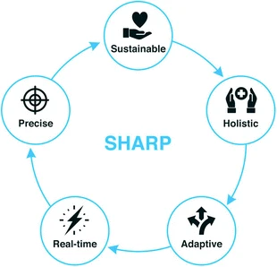
Sustainable, Holistic, Adaptable, Real-Time, and Precise (SHARP) Approach Towards Developing Health and Wellness Systems

Slide 62
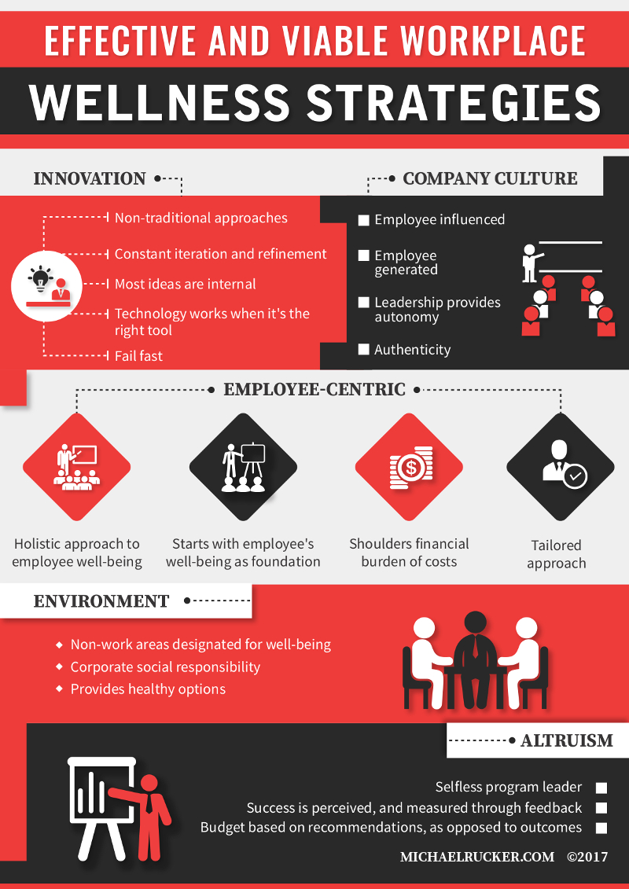
Company culture
Employee-centric
Environment
Altruism
Innovation
Workplace Wellness Strategies for Small and Mid-Size Businesses Michael Rucker.com

Slide 63
Effective Workplace Strategies
Individual and Organizational Leadership
Culture
Communication
Supports
Education and Training

Slide 64
What would you do?
What if you knew you were going to die two years from now (and your health was not an obstacle), how would you spend your remaining time?

Slide 65
Case Study Vignettes

