Slide 1
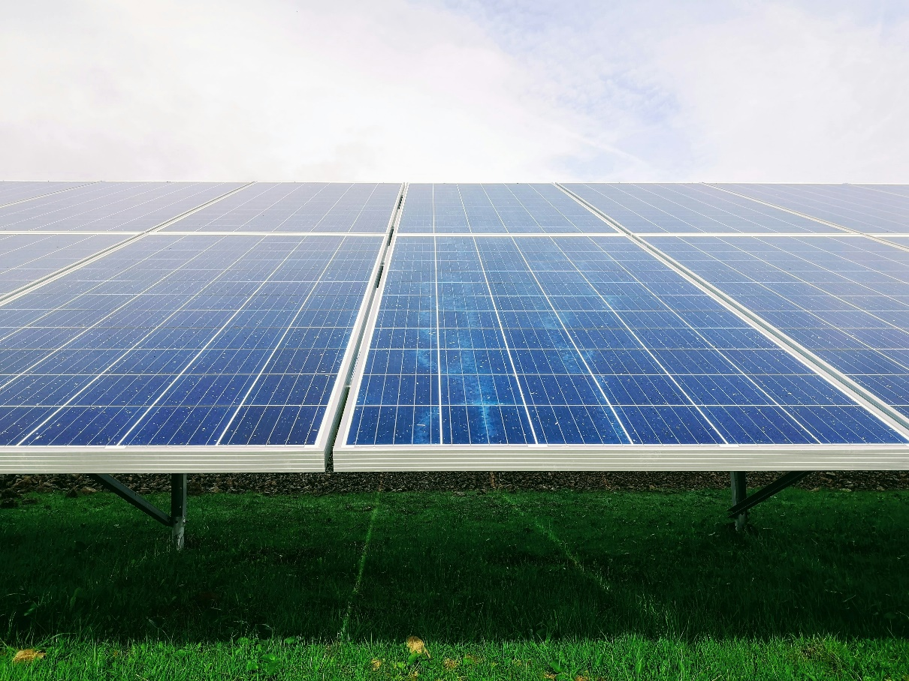
Pioneer’s Solar Initiative: Sustainable Growth
& Environmental Responsibility
How Pioneer Resources identified and pursued the Michigan Renewable Energy Grant
Notes:
Good morning, friends. I’m Stacy Freed, Chief Clinical Officer at Pioneer Resources. Thank you for the chance to share one of our most exciting projects. Recently, Pioneer Resources connected with an incredible opportunity: a Renewable Energy Grant from the Michigan Public Service Commission. This project was part of our ongoing efforts to seek funding that actively strengthens our environmental and financial sustainability. We applied for this grant to bring solar power to eight of our locations, and we’re thrilled to see it moving forward.

Slide 2
State Initiative Supporting Climate Goals
Michigan’s Public Act 119 of 2023: $20.8M to Advance MI Healthy Climate Plan.
Pioneer selected from 52 applications for renewable energy initiative.
The grant application totals were more than $147 million across the state.
Pioneer Resources was selected as a recipient for a project that would install solar and almost completely offset the electrical usage at 8 sites.
Notes:
This opportunity came through Michigan’s Public Act 119 of 2023, which allocated $20.8 million to reduce greenhouse gas emissions and promote sustainable practices statewide. Michigan’s Public Service Commission selected Pioneer Resources from 52 applications totaling more than $147 million. By supporting solar installations, they are enabling nonprofits like ours to meet state climate goals while enhancing our operational sustainability.

Slide 3
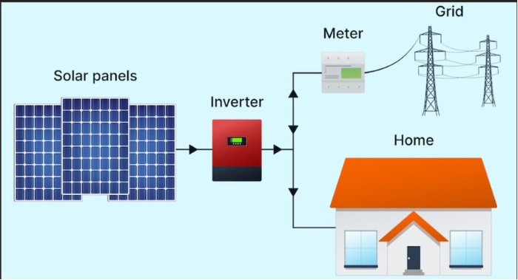
Project Overview
Locations include: Administration, Transportation, and 6 residential homes.
Covers nearly 100% of electricity needs, saving 80% on energy bills.
Allows reinvestment of savings into programs supporting individuals with disabilities and seniors.
Notes:
The grant covers solar installations across eight Pioneer-owned sites, including our administration offices, transportation department, and six residential homes. These photovoltaic systems are expected to cover almost all our electricity needs and reduce our energy bills by about 80%. This project saves on utility costs and aligns perfectly with our mission by allowing us to redirect those savings back into essential programs and services for the people we support.

Slide 4
Strategic Funding for Sustainability
RE-EIED Grant: Covers 70% of project costs + $53,295 for administration.
The grant-seeking approach aligns financial sustainability with mission goals.
Notes:
The Renewable Energy and Electrification Infrastructure Enhancement and Development Grant covers 70% of our project costs, including an additional $53,295 for administrative expenses. This grant-seeking approach has been crucial to making Pioneer’s sustainability goals a reality. By focusing on strategic funding sources, we can support our financial stability and our mission innovatively.

Slide 5
Leveraging Federal Support for Full Funding
2022 Inflation Reduction Act: Renewable Energy Tax Credit as a direct payment to nonprofits.
Federal support covers the remaining 30% of costs.
Innovative use of layered funding for sustainable impact.
Notes:
We can also leverage federal support. Nonprofits can now receive tax credits as direct payments through the Renewable Energy Investment Tax Credit, part of the 2022 Inflation Reduction Act. Once our solar installations are complete, we can apply for federal funds to cover the remaining 30% of costs. If needed, Michigan Saves, a financial partner providing access to customized home solutions to reduce energy bills, even offers a low-interest bridge loan option, providing short-term funding while waiting for federal reimbursement.

Slide 6
Creating a Legacy of Financial & Environmental Impact
Year 1 electricity bill savings of $31,470
30-year savings projected at nearly 2 Million
Supports Pioneer’s mission by reinvesting in programs and services
Notes:
Let’s talk about the lasting impact. This solar project will cover nearly 100% of our electricity needs and reduce our energy bills by 80%. In the first year, we’re estimating savings of around $31,470. Over the next 30 years, this adds up to nearly $2 million saved—funds that will be reinvested directly into our programs and services. With an expected lifespan of over 30 years, this project will help us provide a stable foundation for years to come, benefiting our persons served, staff, and community.

Slide 7
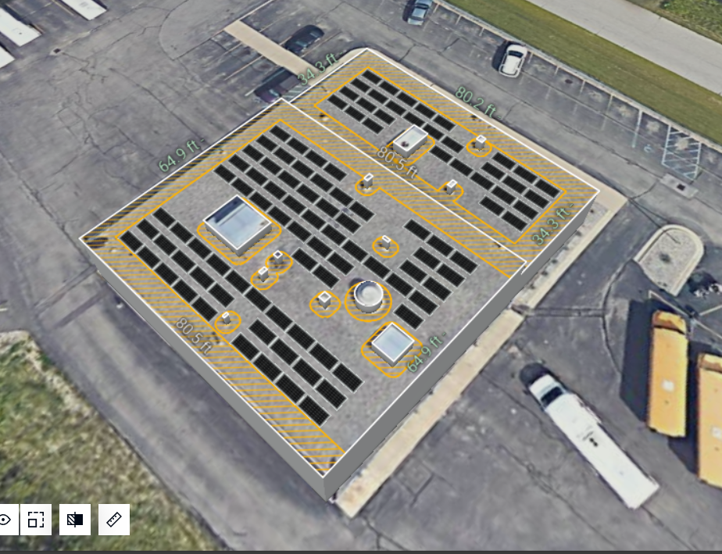
Stacy Freed
Chief Clinical Officer
sfreed@pioneerresources.org
Allen Bonthuis
Vice President of Sales and Marketing
allen@harvestsolar.com
Notes:
Thank you all for your interest in Pioneer Resources’ journey toward renewable energy and sustainability. Feel free to reach out to me or our project partner, Allen Bonthuis at Harvest Solar, if you’d like to learn more.

